Slide 1

IPO RESEARCH REPORT · 2025
Horizon Reclaim India Ltd
IPO Valuation & Prospectus Analysis · NSE/BSE Listing · Issue Size: ₹850 Cr

Slide 2

COMPANY OVERVIEW
India's Leading Waste-to-Energy Platform
Founded
Business
Scale
2015 · Ahmedabad, Gujarat
Waste processing, RDF, power generation
42 plants · 18 states · 3.2M tons/yr
Pre-IPO Revenue: ₹620 Cr · EBITDA: ₹148 Cr · PAT: ₹62 Cr

Slide 3
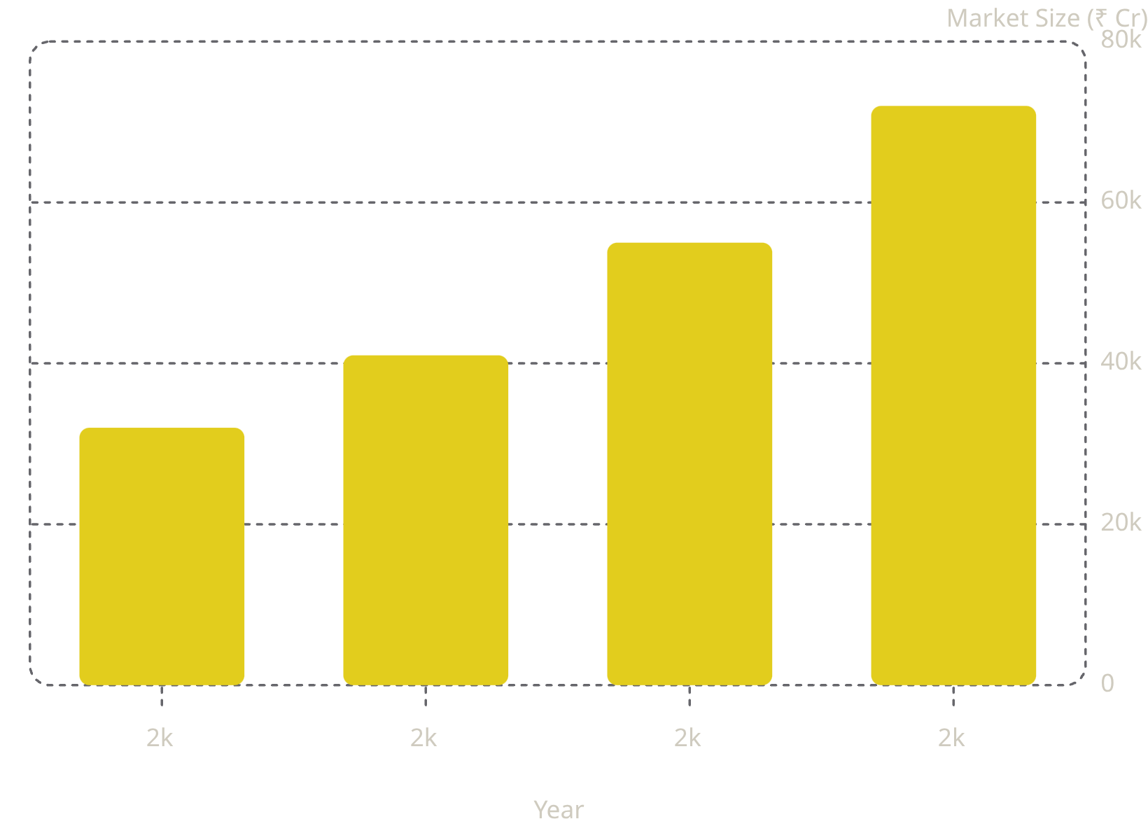
INDUSTRY ANALYSIS
A ₹1.2 Trillion Market Opportunity
Key Industry Tailwinds
Policy Push: Swachh Bharat 2.0 & CPCB mandates driving municipal contracts
Urbanization: India's urban waste growing at 8% CAGR through 2030
ESG Mandates: SEBI BRSR requirements accelerating corporate procurement

Slide 4
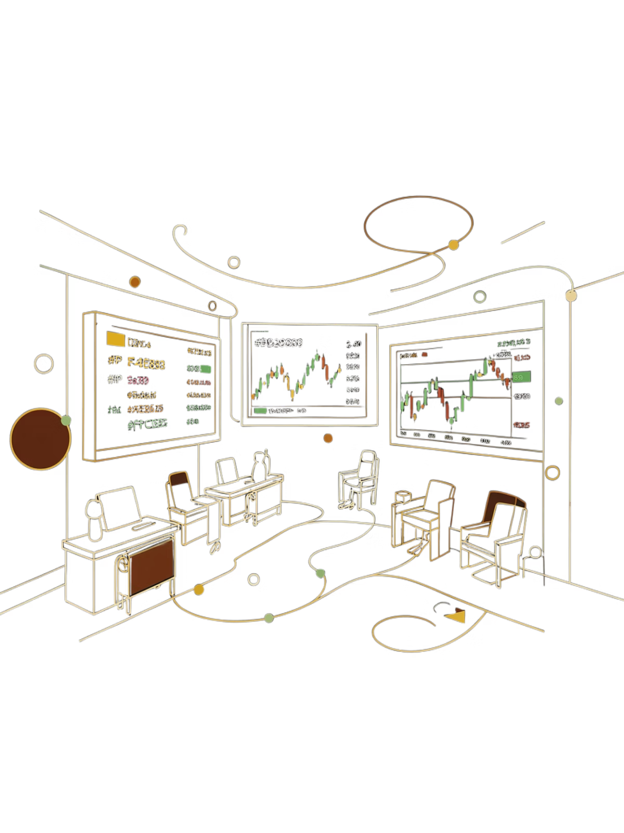
IPO DETAILS
Offer Structure & Use of Proceeds
₹850Cr
Total Issue Size
Fresh Issue + OFS
₹185
Price Band
Per Equity Share
4.6M
Shares Offered
Fresh + Promoter OFS
25x
Subscription
QIB Category (Day 2)

Slide 5
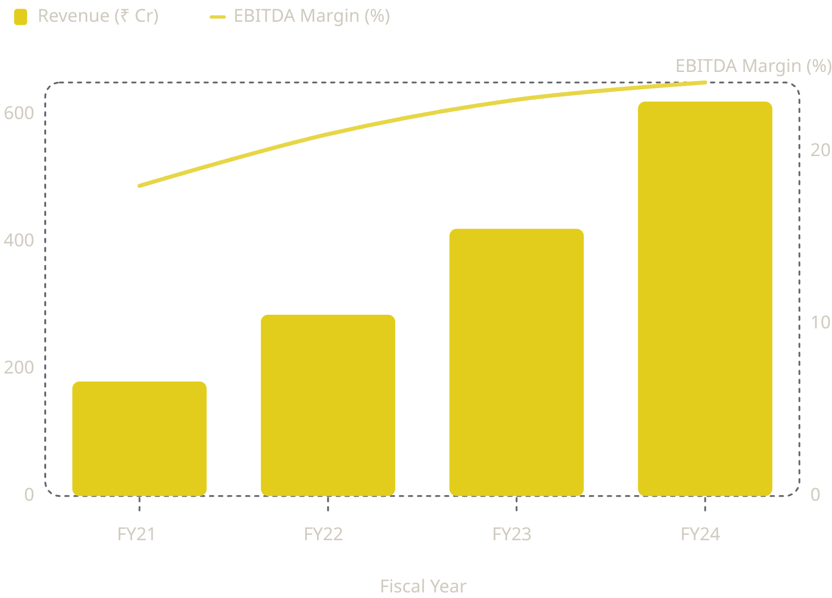

FINANCIAL ANALYSIS
Strong Revenue Growth, Expanding Margins
Financial Highlights
Revenue CAGR (FY21–FY24): 51%
EBITDA margin expanded +600 bps in 3 years
Net Debt/EBITDA: 1.2x — conservative leverage
ROCE: 18% vs. industry avg. 12%
FY24 PAT of ₹62 Cr implies ~10% net margin — above peer median of 7%

Slide 6
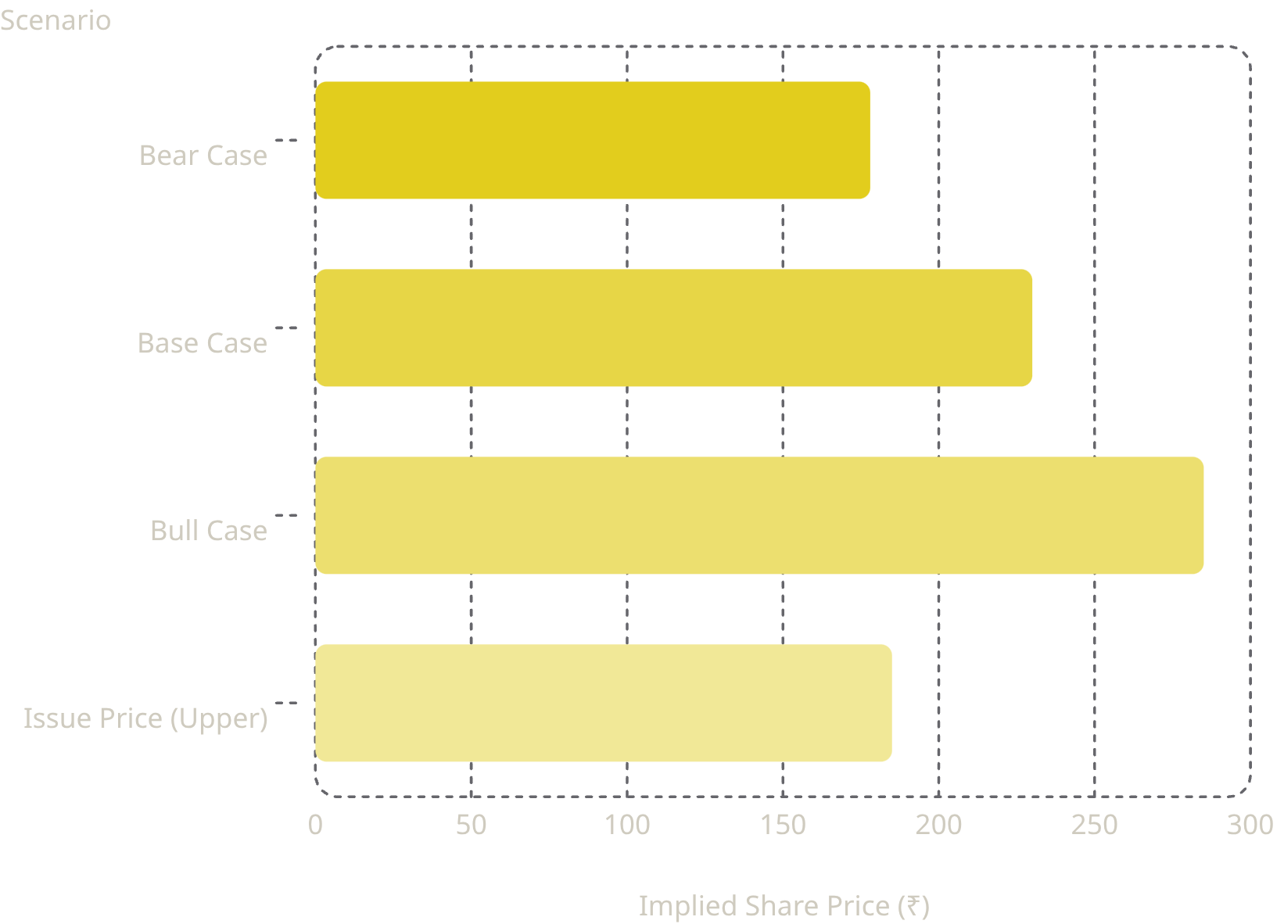

DCF VALUATION
Intrinsic Value: ₹212–₹248 Per Share
Key Assumptions
WACC: 10.5% · Terminal Growth: 4.0%
Revenue CAGR (5-yr): 22% · Tax Rate: 25%
Enterprise Value (Base): ₹2,850 Cr
Base case implies 24% upside to upper price band of ₹185

Slide 7
COMPARABLE COMPANY ANALYSIS
Trading at a Modest Premium to Peers
Company
EV/EBITDA (x)
P/E (x)
EV/Sales (x)
ROCE (%)
Horizon Reclaim (Implied)
14.2x
22.5x
3.8x
18%
Indorama Ventures
12.5x
19.0x
2.9x
14%
TCPL Packaging
15.8x
24.0x
4.1x
16%
Enviro Infra Engineers
13.0x
20.5x
3.2x
15%
Peer Median
13.0x
20.5x
3.2x
15%
Horizon trades at a 9% EV/EBITDA premium to peer median — justified by superior ROCE and growth profile.

Slide 8
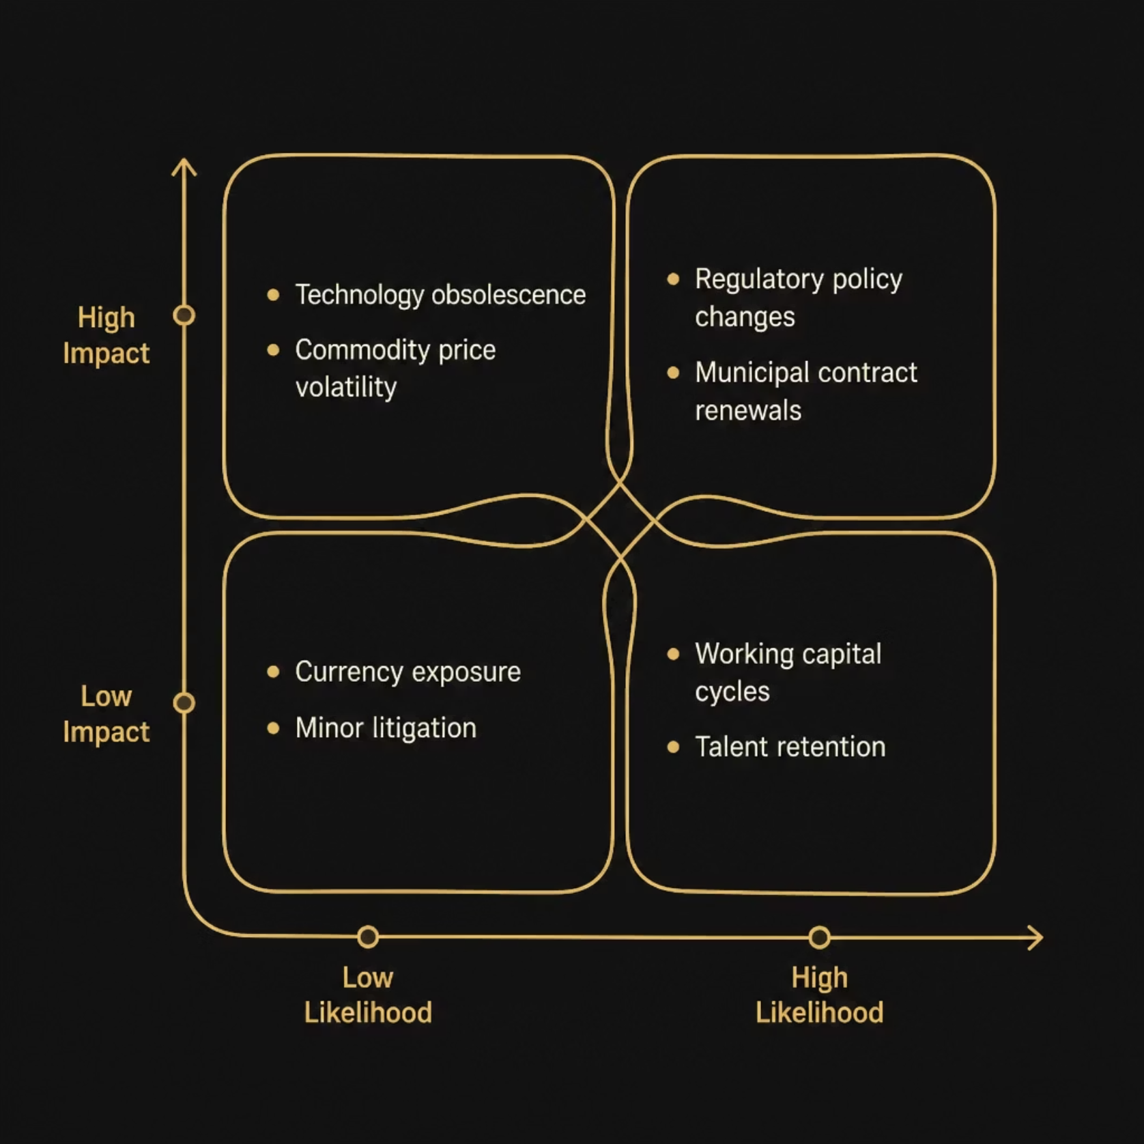
RISK ASSESSMENT
Risk Matrix: Key Investor Concerns
Primary Risk Factors
Regulatory: Policy shifts in waste management mandates
Concentration: Top 5 clients = 38% of revenue
Execution: 12 new plants in pipeline — capex risk

Slide 9




ESG ANALYSIS
ESG Leadership as a Valuation Catalyst
92%
78%
Waste Diversion Rate
Women in Workforce
vs. industry avg. 61%
Operational & leadership roles
100%
35%
BRSR Compliant
Carbon Reduction
SEBI reporting since FY22
vs. 2020 baseline
ESG score: AA (MSCI) — eligible for ESG-dedicated funds; reduces cost of capital by ~80 bps

Slide 10

INVESTMENT RECOMMENDATION
SUBSCRIBE — Strong Buy at Issue Price
Price Targets
✅ Growth Thesis
✅ Valuation Gap
₹185 — Upper Issue Price (Entry)
1
51% revenue CAGR; ₹1.2T TAM
24% upside to base-case DCF
2
₹230 — 12-Month DCF Target
✅ ESG Premium
AA-rated; fund eligibility
₹285 — Bull Case (24-Month)
3
Rating: SUBSCRIBE · Risk: Medium · Horizon: 18–24 Months

